Slide 1
Security Workshop
Carsten Hufe Senior Data Engineer
October 2017
Notes:
Change copyright to 2016

Slide 2
Agenda
Fundamentals | Core
Basic security Authentication Authorisation Encryption Auditing Impersonation | Enable Platform Security Maprlogin utility MapR-FS ACEs Auditing Encryption

Slide 3
Fundamentals Basic Security Concepts

Slide 4
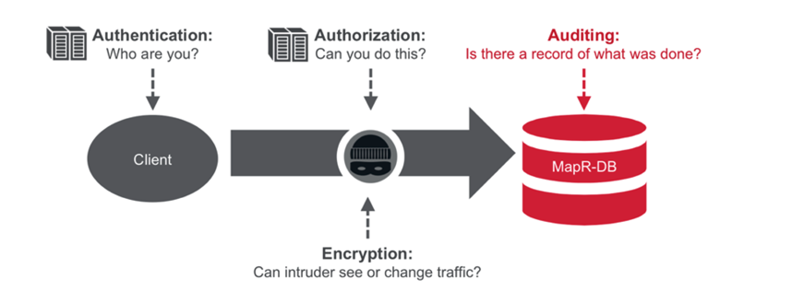
Fundamentals

Slide 5


MapR Security Summary
Encryption for Data in Motion
Within a Cluster
Between Clusters
Between Client and Cluster
Encryption for Data on Discs
LUKS
Self-Encrypting Disk
Partners
NSA-level cryptographic algorithms
1
2
Wire-level authentication for all services in the cluster
Integration with LDAP, Active Directory and other third party directory services
Kerberos or username/password authentication
Ubiquitous
Data Protection
Flexible Authentication
DP
A
A
A
A
1010101001001 10001000100101101001010100101001010101010101100
All events recorded immediately in JSON log files
Includes data access and administrative actions
Ad-hoc queries and custom reports on audit logs via SQL and standard BI tools
3
4
Access Control Expressions
Protect files, tables, column families, columns, and management objects
Extend to role-based access control (RBAC) with custom role functions
Drill Views
Granular
Authorization
Robust
Auditing
Notes:
In computing, the Linux Unified Key Setup or LUKS is a disk encryption specification created by Clemens Fruhwirth in 2004 and originally intended for Linux.
Ubiquitous = allgegenwärtig
Network traffic between …
Cross cluster communication

Slide 6








MapR Converged Data Platform
Open Source Engines & Tools
Commercial Engines & Applications
Processing
Search &
Others
Cloud & Managed Services
Custom Apps
Unified Management and Monitoring
Utility-Grade Platform Services
Data
Enterprise Storage
Database
Event Streaming
MapR-FS
MapR-DB
MapR Streams
Global Namespace
High Availability
Data Protection
Self-healing
Unified Security
Real-time
Multi-tenancy

Slide 7
Fundamentals Authentication

Slide 8
MapR Native Security
Platform security without Kerberos
But borrows heavily from Kerberos design
Password authentication is natively supported
Kerberos integration if desired

Slide 9
Architecture
Shared secrets like Kerberos
Managed at cluster level
Two shared keys: cldb key and server key
Identity represented using a ticket which is issued by MapR CLDB servers

Slide 10
Tickets
A ticket represents a valid authenticated identity
Contains
An expiration time, renewal lifetime, and creation time
A randomly generated secret key
Information about the identity – userid, group ids
Signed and encrypted when issued by CLDB
CLDB key used for ‘permanent’ server tickets
Server key used for ephemeral tickets issued for users
A client authenticates to trusted servers using the ticket

Slide 11
User Experience
User invokes maprlogin
maprlogin connects to CLDB (over https)
Provide userid & password (or Kerberos ticket) for validation by CLDB
Ticket is returned, saved in file in /tmp folder and accessible only by owning user – file name is /tmp/maprticket_<uid>
All processes automatically pick up ticket (nothing to do)
Java and C/C++ clients implicitly look for valid ticket and use it
MapR PAM module
Optional MapR provided PAM module creates MapR tickets automatically during Unix login

Slide 12
Kerberos
Not required but can use
Kerberos SSO
Explicitly using ‘maprlogin kerberos’
Implicitly
If no MapR ticket available, client automatically detects and uses Kerberos ticket and uses it to obtain MapR ticket
Kerberos SSO requires only
Kerberos client on CLDB and client machines
Kerberos identity only for CLDB – typically 3-5 CLDBs
No need to manage identities for every node
SPNEGO/Kerberos for Web UIs requires creating host Kerberos identities

Slide 13
MapR Native Security Advantage
Vastly simpler
Core secured by default in one step
No requirement for Kerberos in core and associated complexity
Easy integration
Leverage existing Linux authentication (PAM and NSSwitch)
Faster
Leverage Intel AES hardware cryptography

Slide 14
Fundamentals Impersonation

Slide 15
Impersonation
Required because services run under a specific user
The requesting user name has to be passed through
When the mapr superuser attempts to impersonate another user
MapR client looks for that user name in local OS registry
If found, MapR sends the user UID and GID to server for impersonation
If not found, user action is not processed

Slide 16
Fundamentals Authorization

Slide 17

Platform Authorization
Consistent Enforcement Across Execution Engines
Authorization at data platform layer is used by all components: MRv1, YARN, Spark, Drill.
As new innovative execution engines come out they leverage automatically.
Hadoop Standard Impersonation
All (except Impala) support Impersonation which projects identity to platform where authorization is enforced
Standard Hadoop Approach
HDFS, HBase also authorize in platform
1010101001001 10001000100101101001010100101001010101010101100

Slide 18



Access Control Expressions
1010101001001 10001000100101101001010100101001010101010101100
Boolean Operators
Allowing for Expressive
Permissions
Users, Groups, and Custom Roles
Reference User Population as Needed in Expressions
High Performance
No Performance Hit

Slide 19
Access Control Expressions (ACEs)
Powerful boolean logic based authorization rules
Expressions use user & group information
Can also specify custom roles via plugin
Expressive – not just OR – include OR, AND, NOT
( u:bob | g:admins)
( g:managers & ! g:restricted)
( g: managers & g:businessunity) | g:executives
Notes:
http://doc.mapr.com/display/MapR/Creating+User+Roles+for+Access+Control+Expressions

Slide 20
The Problem with POSIX Permissions
POSIX Permissions
-rw-rw---- bruce dev-team
user
other
group
Scenario 1:
Sally Needs to Read the File
Scenario 2:
Groups ‘QA’ and ‘Support’ Need to Read the File.
Scenario 3:
All Members of dev_team Except
Bob Need to Read the File.
Change ownership of file to Sally.
Add Sally to dev_team group, even if she’s not a developer.
Allow ‘others’ to read the file.
Allow ‘others’ to read the file.
Create a supergroup ‘Tech’, and include all members from dev, QA, and Support in that group. chgrp Tech <filename>
???
1010101001001 10001000100101101001010100101001010101010101100
POSIX Permissions Are Limiting

Slide 21
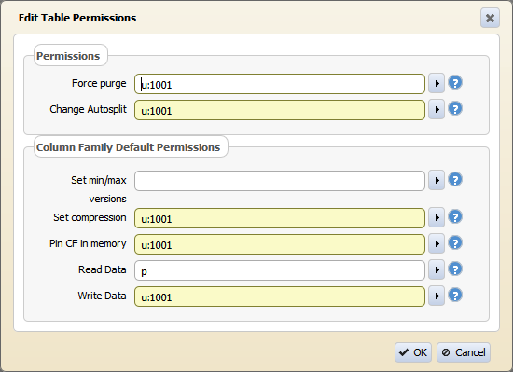
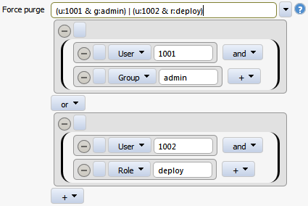

Table ACEs
Use Access Control Expressions (ACEs) to set granular permissions.
1010101001001 10001000100101101001010100101001010101010101100
Example: user:mary | (group:admins & group:VP) & user:!bob
Settable at table, column family, and column level
Extended to field level based upon path in document with MapR-DB JSON

Slide 22




MapR 5.1
File ACEs
1010101001001 10001000100101101001010100101001010101010101100
Per File and Directory
Protects each file as a whole expressively
Intuitive Inheritance
Subdirectories and Files Inherit Perms from Parent Directory

Slide 23



MapR 5.1
Whole Volume ACEs – Multi-Tenancy Enforced
Whole-Volume ACE
r: group:finance
Jane grants read access to Bob.
File: /finance/Q4/reports/final_report r: user:bob
Whole-Volume ACE
1010101001001 10001000100101101001010100101001010101010101100
Bob cannot read the file/finance /Q4/reports/final_report because the whole-volume ACE is set to allow read-access to finance only.
Jane
(Finance)
Bob
(Developer)

Slide 24
Compatibility Note
ACEs are not exposed or simulated via NFS ACLs or HDFS ACLs
As such APIs and tools using those interfaces will not work with ACEs
ACEs are always enforced of course, just not visible via NFS and HDFS APIs
MapR provides CLI, REST, and Java interfaces for manipulating ACEs

Slide 25


Advanced Granular Security Permissions with Drill Views
Raw File (/raw/cards.csv)
Owner
Admins
Permission Admins
Name | City | State | Credit Card #
Dave | San Jose | CA | 1374-7914-3865-4817
John | Boulder | CO | 1374-9735-1794-9711
Owner
Admins
Permission
Business
Analysts
Owner
Admins
Permission
Data
Scientists
1010101001001 10001000100101101001010100101001010101010101100
Business Analyst View
Data Scientist View (/views/maskedcards.csv)
Name | City | State
Dave | San Jose | CA
John | Boulder | CO
Name | City | State | Credit Card #
Dave | San Jose | CA | 1374-1111-1111-1111
John | Boulder | CO | 1374-1111-1111-1111
Business Analyst
Data Scientist
Not a physical data copy

Slide 26
Action Authorization
In addition to data authorization there are many other access control points in the system
Cluster admin – ACLs on MapR cluster
Volume admin – ACLs on MapR volumes for admin
MRv1/YARN Job queues – ACLs on queues for job submission and administration
Oozie – ACLs on job submission as well
HBase – ACLs on admin tasks against tables

Slide 27
Fundamentals Auditing

Slide 28












MapR Platform Auditing – Key Features
Data Access
Files
MapR-DB Tables
Streams
Cluster Operations
Administrative Operations
Maprcli commands
Authentication Requests
1010101001001 10001000100101101001010100101001010101010101100
{"timestamp":"{$date=2015-06-01T05:24:58.231Z}","operation":"GETATTR","user":"root","uid":"0","ipAddress":"10.10.x.x","nfsServer":"10.10.x.x","srcPath":"/dbtest.0/","srcFid":"2147.16.2","VolumeName":“mktg_files","volumeId":“mktg_files","status":"0"}
Secure High Performance
Flexible
Retention Period
Maxsize
Coalesce Interval
JSON Format
Notes:
Auditing = We track changes on a specific resource.
Restrict and allow data access on files, MapR-DB Tables and streams are tracked.
We can easily peform cluster operations by using administrative commands and MapR-CLI commands.
An easy way to perform authentication requests bia CLDB and with native security.
MapR provides a secure high performance auditing solution.
It is flexible, because you can configure retention periods, max size and coalesce intervals)

Slide 29
Platform Auditing
Feature adds auditing to MapR unique components
Auditing added to MapR-FS/MapR-DB/CLDB
We inherit other auditing from Apache open source
What is there or is not there is not within the scope of the feature
Four types of MapR Unique Auditing
CLDB Auditing (I’ll call this administrative auditing for simplicity)
Authentication auditing
maprcli “auditing”
Data access auditing
Record of access/change, not record of actual change

Slide 30
Auditing Use Cases
Detecting unauthorized cluster changes and data access
Who touched customer records outside of business hours?
What actions did users take in the days before leaving the company?
What operations were performed without following change control?
Are users accessing sensitive files from protected or secured IP addresses?
Complying with regulatory frameworks and legislation
Data usage heatmaps on most and least frequently used data
e.g. can be analysed with Drill, because it’s JSON
Data access analytics and performance improvements
Data protection policies on data that matters using snapshots and mirroring
Notes:
Unauthorized cluster changes and data access
Enabling audit logging at the cluster level provides great value when it comes to who changes what from an administrative point of view on the MapR cluster. Since it also logs both successful and unsuccessful login attempts on the MapR cluster, it provides insight into people trying to get unauthorized access to the cluster based on the amount of failed login attempts. In parallel, logging operations at the filesystem and table level allow cluster administrators to answer the following important questions
Complying with regulatory frameworks and legislation
The auditing information is very useful when your company needs to comply with strict regulations and legislations. In case of a compliance audit by an external independent accounting firm, the audit log files provide all necessary information on who did what on the cluster. This greatly reduces the time an external audit takes, and therefore saves your company valuable time and money. It also increases the level of your organization's maturity level while protecting your brand from reputation damage by unauthorized data access.
Data usage heatmaps on most and least frequently used data
Since the data access audit logs are written in the JSON file format, it’s easy to generate data usage heatmaps using your favourite Business Intelligence tool and Apache Drill. Creating these kinds of heatmaps on cold, warm and hot data allows you to advise your users on important and valuable data,as well as on rarely used and unexplored data.
Data access analytics and performance improvements
The heatmaps I described above are also important information for cluster data layout planning. One use case can be that end users are experiencing a decrease in performance on a data volume. When creating the initial cluster layout, the administrator might have set a volume’s replication level to the standard of three replicas (this means there are three cluster nodes able to serve the data in case of an end-user request). Although the MapR Container Location Database (CLDB) spread the load across the cluster to remove hotspots, the amount of data requests could be too high for the replication level set. Based on actual data usage as shown in the heatmaps (either by end user, mapreduce jobs, Spark Streaming applications or others), it might be beneficial to increase the replication level to increase data locality, and have more nodes able to service this specific data volume. This will greatly improve end-user experience on data access performance.
Data protection policies on data that matters using snapshots and mirroring
To make sure that your company's crucial data is safe, the heatmaps can be of great assistance when reviewing your snapshot and mirroring policies as currently deployed on the cluster. Data volumes that have many update and delete activities going on are candidates for a high frequency snapshot policy. This is to avoid disaster in case important data gets accidentally overwritten or deleted by end-user mistakes. Additionally, you should review the mirroring of these frequently used data volumes to make sure this data is available in a secondary location. That way, your company will be able to continue operating, even if you experience a disaster in your primary data center.

Slide 31
Fundamentals Encryption

Slide 32
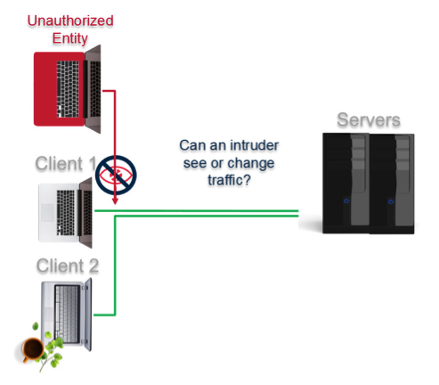
Encryption Goal

Slide 33
Encryption – On the Wire
Three variants depending on component
MapR native security/maprsasl
AES 256 GCM Mode (NIST approved)
Used by file servers for file, table, and stream traffic as well as YARN communication and a few ecosystem components
HTTPS/TLS
TLS 1.2 enforced
Used by Web interfaces as well as some ecosystem components
Kerberos
Used by some ecosystem servers for communication
Notes:
National Institute Standard Technology

Slide 34
Wire Encryption Granularity
Encryption enabled/disabled at file/directory level
Each file/table/stream can have encryption on or off as preferred (default is off)
Encryption for new files/tables/streams and directories inherited from parent (just like compression)

Slide 35







Encryption - Disks
1
2
Health Records
SSN
Name+ Age+Address
Credit Card #
Volume
3
Use Partners for Masking,
Format Preserving Encryption
1010101001001 100010001001011010010101001 01001010101010101100
Self-Encrypting Disk
Sensitive Data
Many Options for Block-Level, Disk-Level, and Field-Level Encryption

Slide 36
Scope of Encryption
All data
Bulk encrypt all data stored
Selected fields within a file
Often this is encryption being used to simulate access control
Would platform access control in structured tables address?
Notes:
Define toplogies in MapR for encrypted disks so that you can decide which volumes have to be encrypted.

Slide 37
Use Cases for Field Level Security Products
Simulate access control via encryption
Decryption based upon access rights
Remove sensitive data from system – changes audit scope
Convert all sensitive data via masking, tokenization, or format preserving encryption and then do NOT provide access to original data
Considerations
Performance
API usability/integration
Referential integrity

Slide 38
Core Enable Platform Security

Slide 39
Let’s Build a Secure Cluster!
Node 1
$ apt-get install mapr….
$ configure.sh –C … -Z … -secure –genkeys
Generates all needed keys for MapR-RPC as well as for HTTPS
Node N
$ apt-get install mapr….
$ scp rootORmapr@node1:/opt/mapr/conf/{cldb.key,maprserverticket,ssl_keystore,ssl_truststore} /opt/mapr/conf
$ configure.sh –C … -Z … -secure
Clients
$ apt-get install mapr… $ scp anyuser@nodeN:/opt/mapr/conf/ssl_truststore /opt/mapr/conf $ configure.sh … -secure

Slide 40
Kerberos Keytab
Best practice
3 tickets per keytab:
HTTP/_HOST@{{ mapr_kerberos_realm }}
mapr/_HOST@{{ mapr_kerberos_realm }}
mapr/{{ cluster_name }}@{{ mapr_kerberos_realm }}
For CLDB and YARN (yarn-site.xml)

Slide 41
Let’s Build a Secure Cluster! / Kerberos
Node 1
$ apt-get install mapr….
$ configure.sh –C … -Z … -secure –genkeys -P "mapr/{{ cluster_name }}@{{ mapr_kerberos_realm }}"
Generates all needed keys for MapR-RPC as well as for HTTPS
Node N
$ apt-get install mapr….
$ scp rootORmapr@node1:/opt/mapr/conf/{cldb.key,maprserverticket,ssl_keystore,ssl_truststore} /opt/mapr/conf
$ configure.sh –C … -Z … -secure
Clients
$ apt-get install mapr… $ scp anyuser@nodeN:/opt/mapr/conf/ssl_truststore /opt/mapr/conf $ configure.sh … -secure

Slide 42
That Was Easy – What Happened?
Secret keys generated for authentication and encryption of RPC traffic
Certificates generated for HTTPS traffic
Configuration updated so that core components authenticate traffic
Most traffic also encrypted
Bulk data transfer encryption optional on per file/directory basis
Web UIs switched to HTTPS
Web UIs require password authentication – RM/JT/TT/MCS
Hadoop Java code switched to maprsasl
Authorization components now rely upon MapR identity

Slide 43
Platform Security Defaults
User experience
Users authenticate using maprlogin and passwords
User ‘mapr’ is admin as always
User must authenticate however, OS identity irrelevant
Operating system identity (on or off cluster) no longer relevant to MapR security
Obviously root user and ‘mapr’ user can read/write /opt/mapr
We’ve also tightened permissions for many directories under /opt/mapr
Web UIs require authentication
MapR CLIs require authentication
hadoop fs/mfs/jar/job/etc
maprcli
Any user can submit jobs, but can only admin their own jobs

Slide 44
Platform Security Defaults
Cluster operations
All MapR servers authenticate to each other
All nodes share common maprserverticket
Nodes can only join cluster if they have maprserverticket
Self-signed wildcard certificates created for HTTPS traffic
ssl_keystore contains certificate and private key, ssl_truststore contains certificate
We set JVM system property: javax.net.ssl.trustStore
Used by Web UIs, MCS, and maprlogin to CLDB
Uses hostname command to get DNS domain for cluster and put that into certificate

Slide 45
Ecosystem Services Security
Ecosystem components each have their own unique security options and defaults on a secure cluster
Many default to requiring authentication and use HTTPS for web traffic
MRv1 and YARN
Hive Server 2
Hive MetaServer
Others require additional configuration
Oozie
Spark
Drill
HBase (Kerberos only)
Documentation details steps for each

Slide 46
Ecosystem Map Reduce Clients
Many components simply generate Map Reduce jobs. As such they implicitly leverage the security we’ve defined for Map Reduce previously. They are:
Hive (except Hive Server)
Pig
Mahout
Sqoop

Slide 47









Putting it All Together
6
Cluster Audits
1
1
Data Audits
2
Production
Test
7
Active
Directory
4
Monitoring
Incident
Response
Secure perimeter with firewalls.
Setup authentication services via Kerberos or Native Security.
Discover sensitive files or mask upon ingest.
Setup authorization:
POSIX permissions
Access Control Expressions
Segregate data thru volume placement
Advanced access control thru Drill Views
Encrypt sensitive data via self-encrypting disk or LUKS.
Turn on cluster and data audits.
Follow normal enterprise security processes: compliance, vulnerability mgmt, monitoring, incident response, forensic analysis.
1010101001001 10001000100101101001010100101001010101010101100
4
3
4
5
Disk
Compliance
7
Vulnerability Management
Notes:
Segregate = Auschneiden absondern
Perimeter = Edge server security

Slide 48
MapR Security Summary
Encryption for Data in Motion
Within a Cluster
Between Clusters
Between Client and Cluster
Encryption for Data at Rest
LUKS
Self-Encrypting Disk
Partners
NSA-level cryptographic algorithms
1
2
Wire-level authentication for all services in the cluster
Integration with LDAP, Active Directory and other third party directory services
Kerberos or username/password authentication
Ubiquitous
Data Protection
Flexible Authentication
DP
A
A
A
A
1010101001001 10001000100101101001010100101001010101010101100
All events recorded immediately in JSON log files
Includes data access and administrative actions
Ad-hoc queries and custom reports on audit logs via SQL and standard BI tools
3
4
Access Control Expressions
Protect files, tables, column families, columns, and management objects
Extend to role-based access control (RBAC) with custom role functions
Drill Views
Granular
Authorization
Robust
Auditing

Slide 49
Core Maprlogin utility

Slide 50
Maprlogin
Primary user visible security tool
Actions are
password - authenticate to a MapR cluster using a valid password
kerberos - authenticate to a MapR cluster using Kerberos
print - print information on your existing credentials
authtest - test authentication as a generic client
end / logout - logout of cluster
renew - renew existing ticket

Slide 51
Maprlogin – Under the Covers
1. username/passwd sent on https
2. uses PAM to authenticate
LDAP/ Kerberos/NIS
maprlogin
MapR CLDB
3. ticket + user key returned
4. ticket + key saved in file in /tmp
6. client sends RPC encrypted with user-key + ticket
FileServer/ CLDB
hadoop fs –ls /
5. cmd picks up ticket + key from file
7. server decrypts ticket to authenticate user and checks permissions

Slide 52
CLI Example
$ hadoop fs -ls /
Bad connection to FS. command aborted. exception: failure to login: Unable to obtain MapR credentials
$ maprlogin password
[Password for user 'fred' at cluster 'my.cluster.com': ]
MapR credentials of user 'fred' for cluster 'my.cluster.com' are written to ‘/tmp/maprticket_1001'
$ hadoop fs -ls /
Found 3 items
-rwxr-xr-x 3 mapr mapr 0 2013-12-10 13:25 /hbase
drwxr-xr-x - mapr mapr 1 2013-12-10 13:25 /user
drwxr-xr-x - mapr mapr 1 2013-12-10 13:25 /var

Slide 53
Core MapR-FS Access Control Expressions

Slide 54
Access Control Expressions (ACEs)
ACE = Authorisation
Can be set on
At the cluster level
MapR cluster operation permissions
At the volume level
MapR volume operation permissions
Root directory permissions
ACEs to access volume data
At the file /directory level
UNIX mode bits (POSIX)
MapR ACEs

Slide 55
Ways to set ACEs
Via command line
$ maprcli acl [show|set|edit] -type [cluster|volume] -name <volume name>
or
$ hadoop mfs -setace -R -readdir ‘u:mapr’ /sampledir

Slide 56
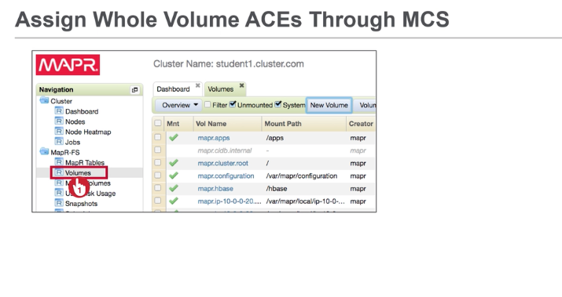
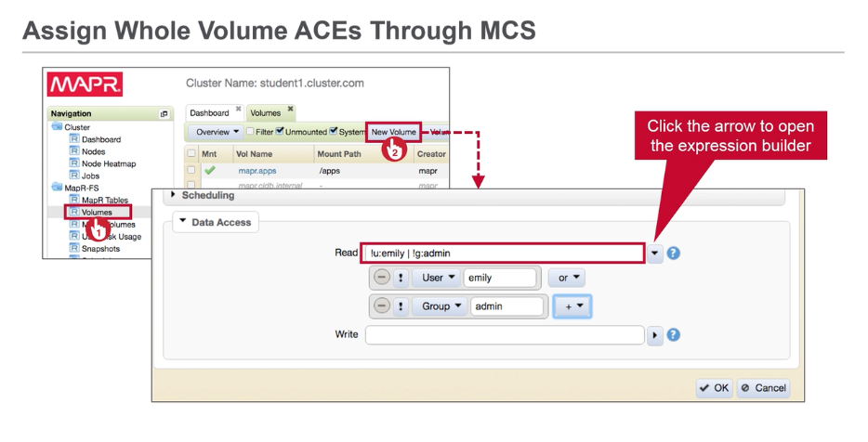
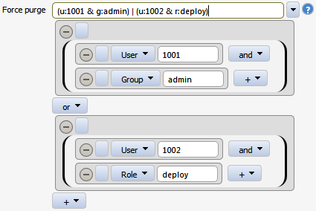
Ways to set ACEs

Slide 57
Access Control Expressions
Whitelist or blacklist users, groups and roles
Boolean expressions and sub-expressions
More configurable than UNIX mode bits
Grant access to everyone in a group except for specific user
Grant permission to custom roles
Can be set on volumes and other entities
Files, directories
Tables, column families, columns
Streams

Slide 58
ACE Entities
Entity | Designator | Description
user | u:<user> | Applies to a user defined at the OS level
group | g:<group> | Applies to a group defined at the OS level
role | r:<role> | Applies to a custom-defined MapR role
public | p | Applies to the public (all members of all users, groups and roles

Slide 59
Simple ACE examples
ACE | What it matches
p | All members of all users, groups and roles
u:jasmine | The user jasmine
g:dev | g:mkt | Anyone who is in the group dev or mkt
g:dev & g:mkt | Anyone who is both groups dev and mkt
!u:donald | Anyone except donald
U:aruna & !g:grp1 | The user aruna who is not member of the group grp1

Slide 60
Whole volume ACEs
One way in which ACEs can be used
Affect read and write access to volume data
Read and write set separately
If the ACE disallows access, entity is denied access
If the ACE allows access, entity’s access may still be denied
Depends on how POSIX mode bits are set on files and directories

Slide 61
ACE Operators
Operators | Symbol | Description
AND | & | Grants access if both conditions are met
OR | | | Grants access if either condition is met
NOT | ! | Grants access if the condition is NOT true
Sub-expression | () | Creates sub-expressions that are evaluated separately before being combined with other conditions

Slide 62
ACE with subexpressions
ACE | What it Matches
u:amy & (r:mkt | g:dev) | The user amy who is member of either the mkt role or the group dev)
(u:amy & r:mkt) | g:dev | The user amy who is member of the mkt role, as well as anyone who is in the group dev
(u:amy | g:mkt) & g:admin | Users who are in either the group dev or mkt, and also in the group admin.
g:dev | (g:mkt & g:admin) | Users who are either in the group dev, or who are in both the groups mkt and admin

Slide 63
Assign Whole Volume ACEs Through CLI
To set a read ACE
To set a write ACE
# Create
$ maprcli volume create -name myvol -readAce ‘u:mark | u:deborah’
# Modify
$ maprcli volume modify -name volA -readAce ‘(g:dev | u:rajesh) & r:adm’
# Create
$ maprcli volume create -name myvol -writeAce ‘u:mark | u:deborah’
# Modify
$ maprcli volume modify -name projectA -writeAce ‘(g:dev | u:rajesh)’

Slide 64
Modify or Remove Whole Volume ACEs
Use the MapR Control System
Use maprcli volume modify to overwrite the previous ACE
To remove an ACE through the command line use the empty string
$ maprcli volume modify -name myvol -writeAce ‘’ -readAce ‘’

Slide 65
Inheritance of Whole Volume ACEs
Snapshots reflect the ACEs of the volume when the snapshot is taken
Updated ACEs do not propagate to older snapshots!
Volume ACEs are propagated to mirror volumes on synchronization
ACEs on promoted mirrors can be different from the source volume
Sub-volumes do not inherit ACEs
Sub-volume: a volume mounted in sub directory of an already mounted volume

Slide 66
Core Auditing for MapR-FS and Cluster

Slide 67

Two types of auditing
Cluster Operations
Administrative Commands
Maprcli Command
Auditing on data
Read actions
File and folder
Creations
Modifications
Deletions
Cluster Auditing
Data Auditing
Notes:
SUPPORT
MapR is focused on raising the bar for product and support capability in the world of Apache Hadoop. MapR delivers highly available resources to assist in all aspects of product deployment and usage.
We created both a breakthrough product and support team to deliver the high level of mission critical support you expect. MapR's support team offers:
24x 7 community, phone and email support options
On-demand patches and proactive update notification
Online incident submission and response
License Management
On-site installation and training

Slide 68
Enable auditing
Verify that feature auditing is enabled
If disabled, execute
$ maprcli config load -json | grep "mfs.feature.audit.support"
"Mfs.feature.audit.support":"1",
$ maprcli config save -values {"mfs.feature.audit.support": "1"}

Slide 69
Verify that auditing is enabled
$ maprcli audit info -json
{
"timestamp":1463519053479,
"timeofday":"2016-05-17 05:04:13.479 GMT-0400",
"status":"OK",
"total":1,
"data":[
{
"data":{
"enabled":"0",
"maxSizeGB":"32",
"retentionDays":"30"
},
"cluster":{
"enabled":"0",
"maxSizeGB":"NA",
"retentionDays":"NA"
}
}
]
}
Data auditing is disabled
Cluster auditing is disabled

Slide 70
Data Auditing
If data auditing is disabled
Enable auditing for volume via CLI
Enable auditing for a folder or file
Audit file are located in MapR-FS
$ maprcli audit data -enabled true
$ maprcli volume audit -name <my_volume> -enable true
$ hadoop mfs -setaudit <on|off> <directory|file|table>
/mapr/my.cluster.com/var/mapr/local/<hostname>/audit/<seq_id>/FSAudit.log-<Date>-<seq_num>.json

Slide 71
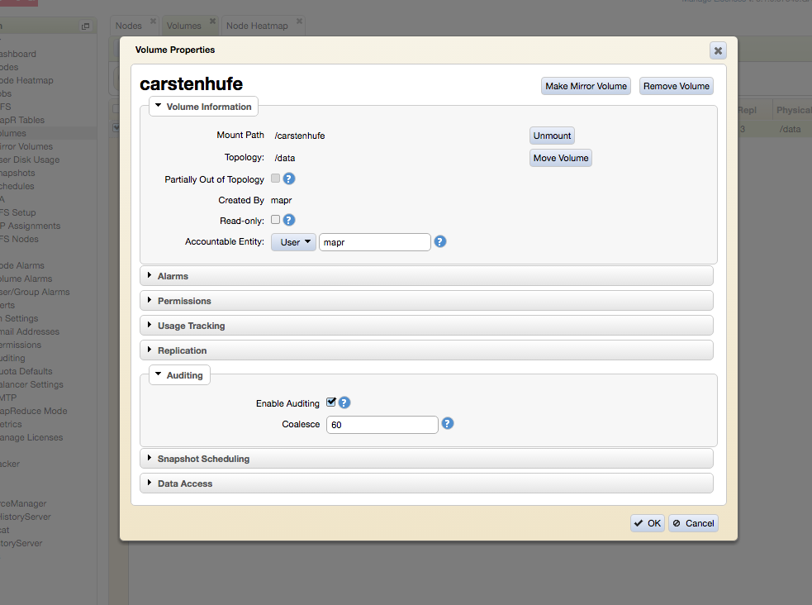
Data Auditing in MCS
Set checkbox

Slide 72
Sample File Audit Log Entries
{"timestamp":"{$date=2015-06-29T12:29:04.767Z}", "operation":"CREATE","user":"mapr","uid":"2147483632","ipAddress":"10.0.2.15","parentPath":"/foo2/","parentFid":"2119.16.2","childPath":"/foo2/file3","childFid":"2119.1330.133994","childName":"file3","VolumeName":"foo2","volumeId":"22788271","status":"0"}
{"timestamp":"{$date=2015-06-29T12:29:04.800Z}", "operation":"WRITE","user":"mapr","uid":"2147483632","ipAddress":"192.168.56.16","srcPath":"/foo2/file3","srcFid":"2119.1330.133994","VolumeName":"foo2","volumeId":"22788271","status":"0"}
{"timestamp":"{$date=2015-06-29T12:29:04.805Z}", "operation":"RENAME","user":"mapr","uid":"2147483632","ipAddress":"10.0.2.15","srcPath":"/foo2/","srcFid":"2119.16.2","dstPath":"/foo2/","dstFid":"2119.16.2","srcName":"file3","dstName":"file4","VolumeName":"foo2","volumeId":"22788271","status":"0"}
Create file
Write to file
Rename file

Slide 73
Cluster Auditing
If data auditing is disabled
Cluster audit files are located local file system on the node
$ maprcli audit cluster -enabled true
/opt/mapr/mapr-cli-audit-log/

Slide 74
Sample CLDB Audit Log Entries
volume list
{"timestamp":{"$date":"2015-06-23T03:01:17.862Z"},"resource":"cluster","operation":"alarmView","uid":500,"clientip":"10.0.2.15","status":0}
{"timestamp":{"$date":"2015-06-23T03:01:17.888Z"},"resource":"cluster","operation":"volumeList","uid":500,"clientip":"10.0.2.15","status":0}
{"timestamp":{"$date":"2015-06-23T03:01:18.000Z"},"resource":"cluster","operation":"volumeList","uid":500,"clientip":"10.0.2.15","status":2}
uid is from MapR ticket id
status is unix errno value

Slide 75
Core Network encryption

Slide 76
Network encryption for volumes
By default, only meta data traffic is encrypted in a secure cluster!
To enforce an encryption for specific data just enter the command for a volume, folder or file.
Keep in mind data encryption adds a lot of overhead!
$ hadoop mfs -setnetworkencryption on /user/<my_user_home>

Slide 77





Q & A
Engage with us!
@mapr
maprtech
mapr-technologies
MapR
chufe@mapr.com
maprtech

